Slide 1
EMPLOYEE SALARY PREDICTION
CAPSTONE PROJECT
Presented By:
1. PRIYADARSHINY DAS- Techno Main Salt Lake- Department Of Computer Science And Engineering- Cyber Security

Slide 2
OUTLINE
Problem Statement (Should not include solution)
System Development Approach (Technology Used)
Algorithm & Deployment (Step by Step Procedure)
Result
Conclusion
Future Scope(Optional)
References

Slide 3
Problem Statement
Salary is definitively one of the most important reasons for a person to be doing a job in today’s world. It is not only the source of one of the most important resources today, but also helps carve out a person’s life and personal position in today’s world, helping to shape a proper and secure lifestyle. Deciding accurate salaries for different job titles and positions is essential for respecting the employee’s hardwork, knowledge, and experience while simultaneously attracting and retaining talent. The core problem is to be able to correctly and precisely estimate salaries for employees based on important factors such as their level of education, knowledge and experience, skills, job title, role, and position, while making sure that both the employee and the employer/organization have proper benefits as a whole.

Slide 4
System Approach
System requirement: Jupyter Notebook.
Library required to build the model:
Numpy
Pandas
Matplotlib
Seaborn
Scikit Learn
LabelEncoder
GridSearchCV
RandomForestRegressor
Warnings

Slide 5
Algorithm & Deployment
The steps carried out to complete this project are as follows:-
Collecting the proper datasets and cleaning them slightly (rearranging colums and deleting columns/features that are not required).
Installing and importing the required libraries.
Reading the files, learning about their basic details, and preprocessing them to remove missing values.
Performing exploratory data analysis.
Encoding the labels.
Splitting the files into the training and the testing sets.
Fine-tuning the model.
Predicting salaries using Random Forest Regression.
Evaluating the model’s performance using suitable metrics.
Performing one final test.

Slide 6
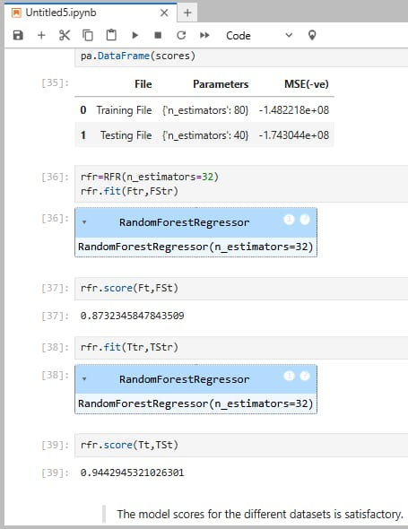
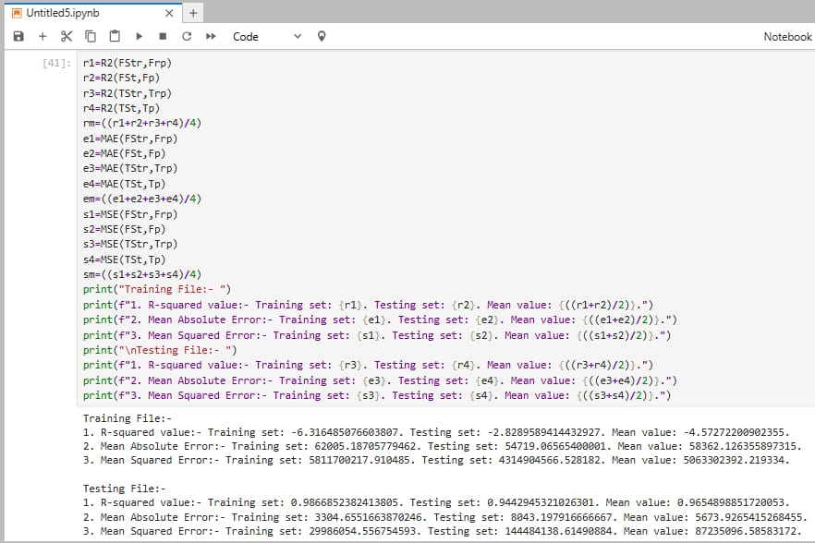
Result

Slide 7
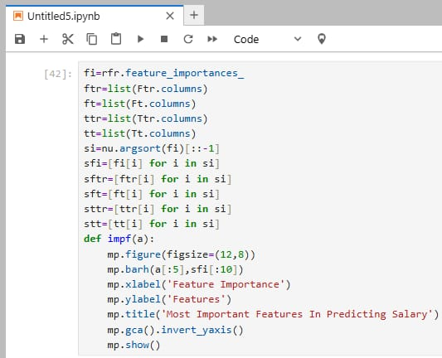
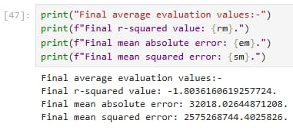
Result

Slide 8
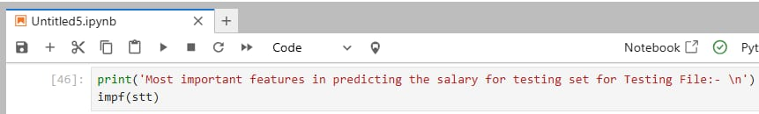
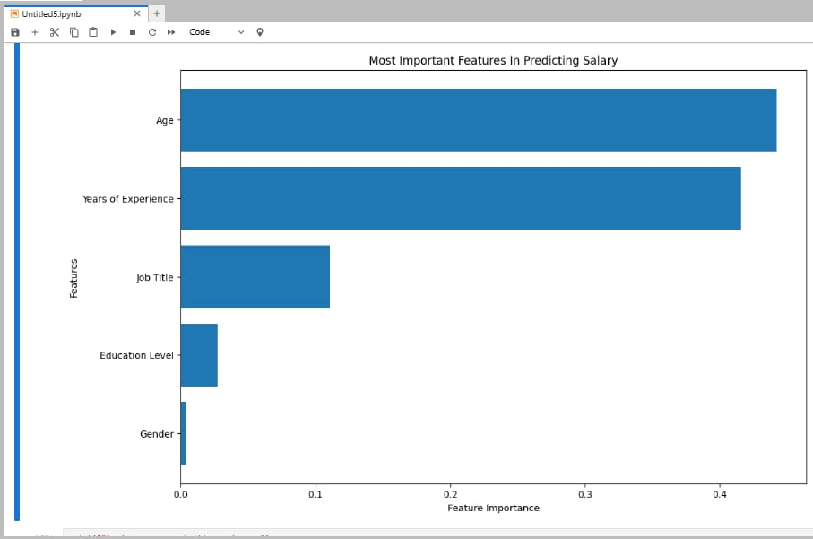
Result

Slide 9
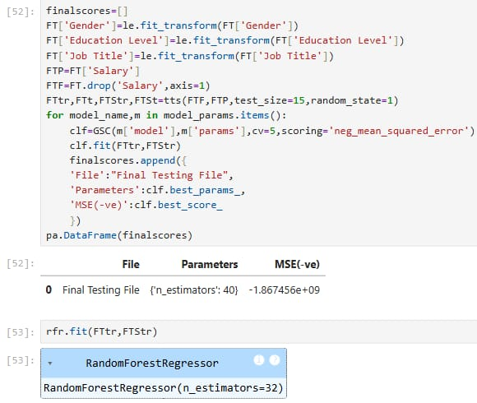
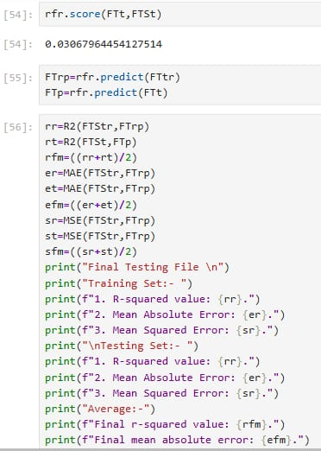
Result

Slide 10
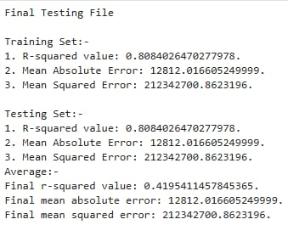
Result

Slide 11
PROJECt LINK
GitHub link:
https://github.com/PERSONAL-PROJECTS-2000/SALARY-PREDICTION.git

Slide 12
Conclusion
Model scores:-
Training file: 0.873
Test file: 0.944
Final test: 0.0306796445
The proposed solution is very effective due to its satisfactory scores on the training and test files. It may therefore be concluded that this model is ready for practical usage and can be utilised to estimate proper salary values for jobs. The final test score is almost equal to 0 as it has very little data and a small and inadequate portion of it has been used for training, as this file was customised mainly for testing purpose.
The only challenging part was searching for proper and clean datasets that had proper features and values and could be used for the project.

Slide 13
Future scope(Optional)
In the future, this model can be expanded by training it further using vast and more accurate datasets for better performance.

Slide 14
References
https://github.com/Pranjali1049/Salary_Prediction/blob/main/Salary%20Prediction.ipynb
https://scikit-learn.org/stable/modules/generated/sklearn.ensemble.RandomForestRegressor.html
https://www.geeksforgeeks.org/random-forest-regression-in-python/
https://naac.iem.edu.in/wp-content/uploads/2024/02/Minor_Project_7A-Avilash-Sengupta.pdf
http://103.47.12.35/bitstream/handle/1/9318/BT4234_RPT%20-%20Mr.%20Sreenarayanan%20N%20M.pdf?sequence=1&isAllowed=y

Slide 15
THANK YOU

